Slide 1
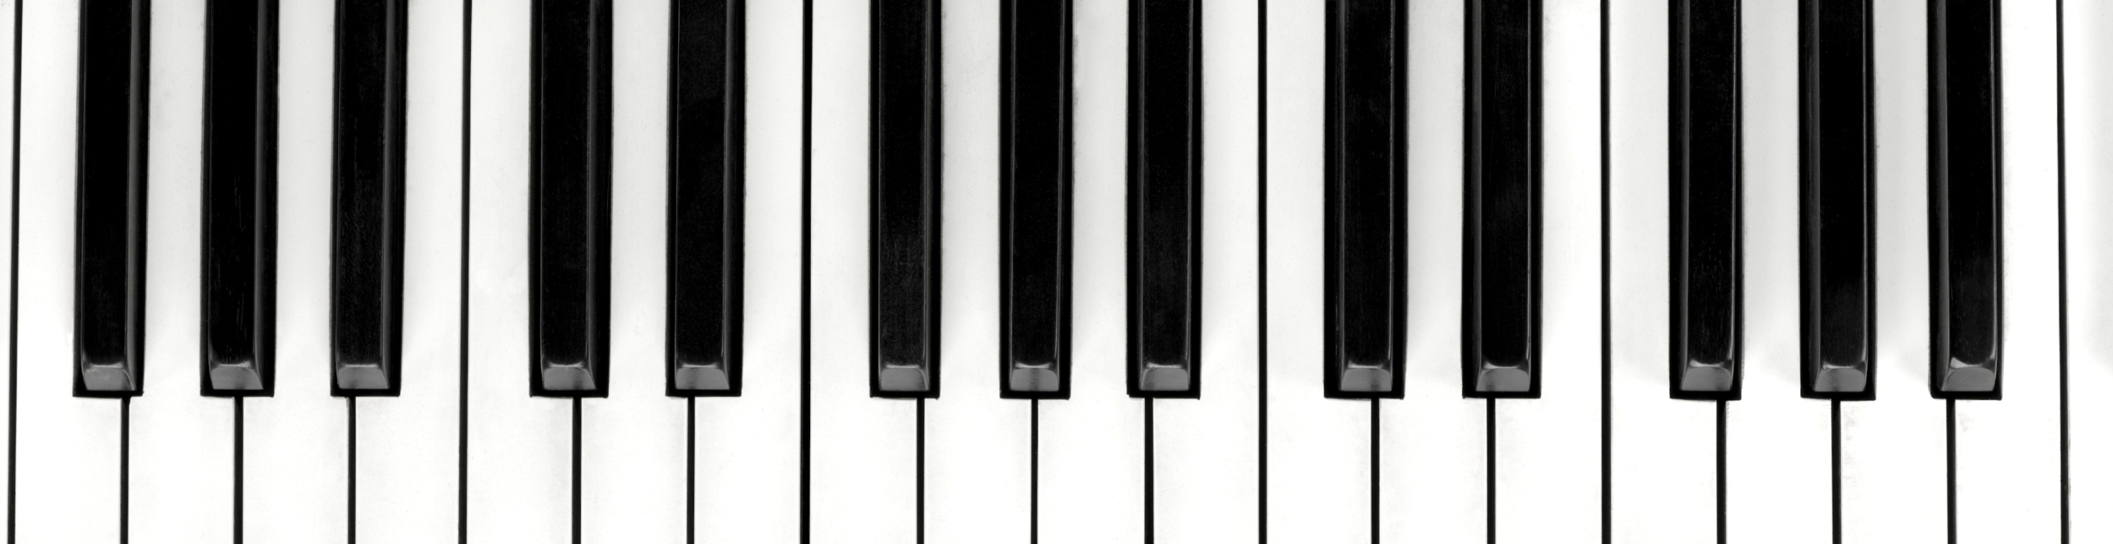
Query by Playing

Slide 2
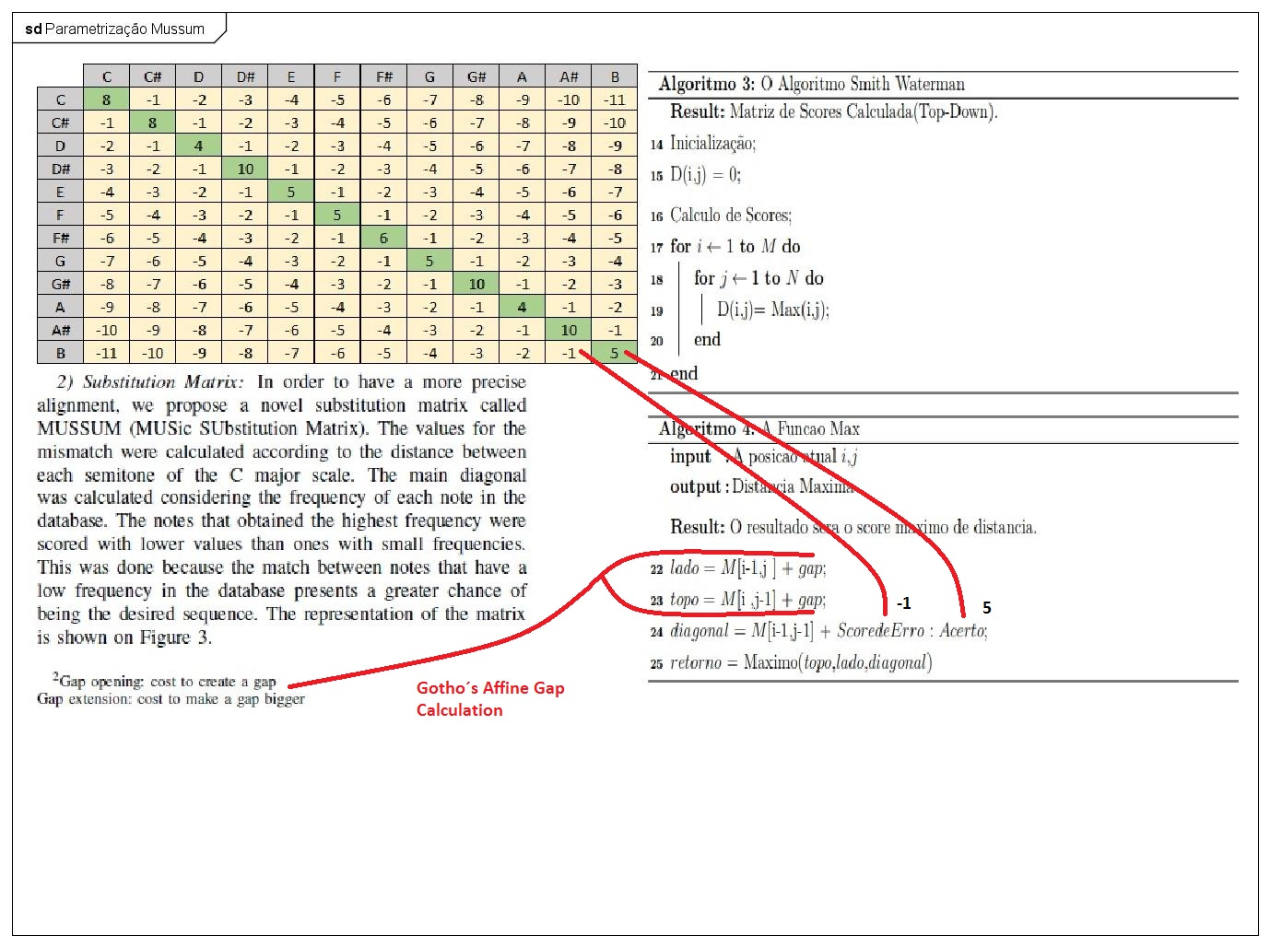
A Matriz MUSSUM

Slide 3
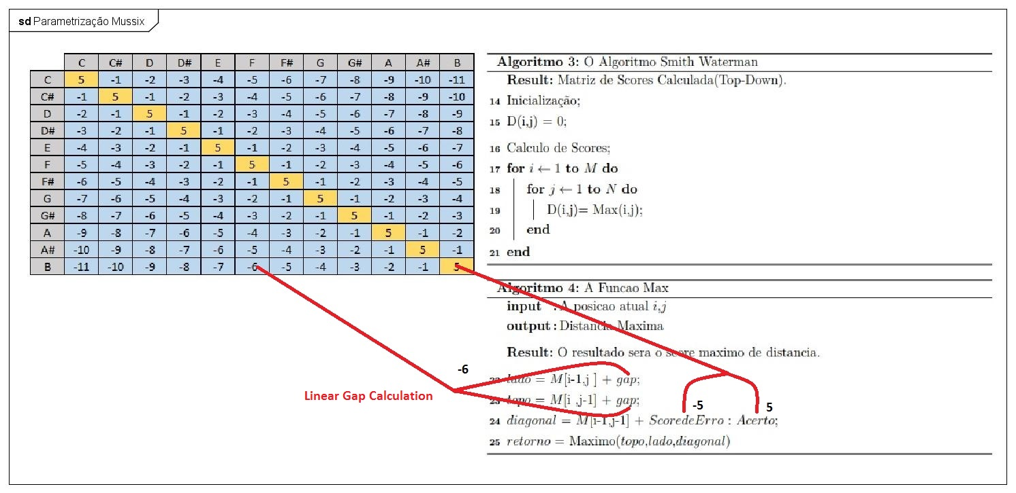
A Matriz MUSSix

Slide 4
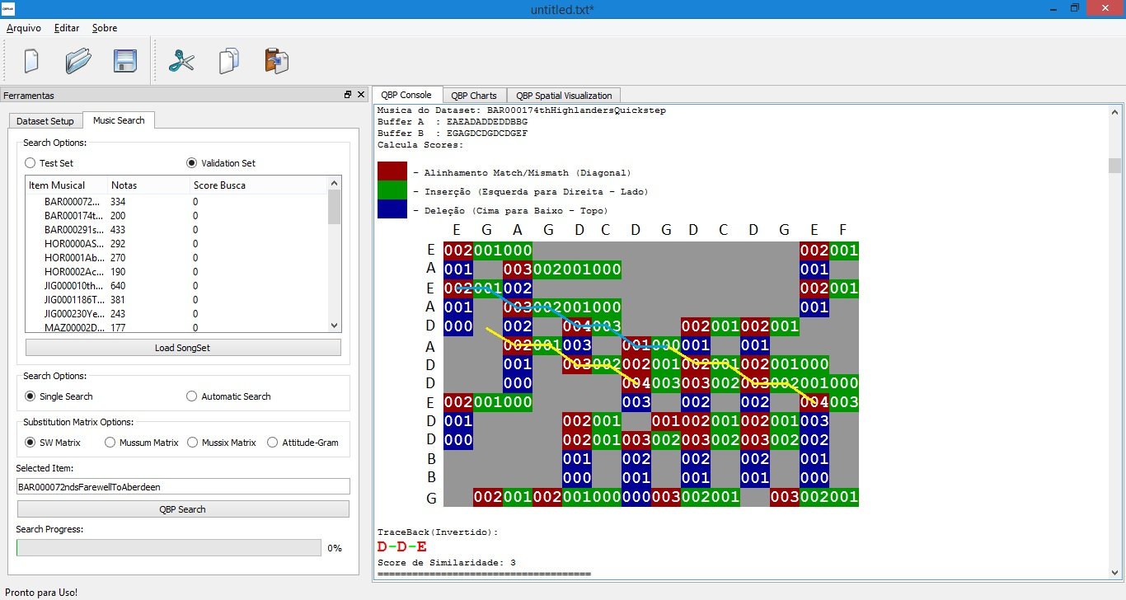
O n-Gram Attitude

Slide 5
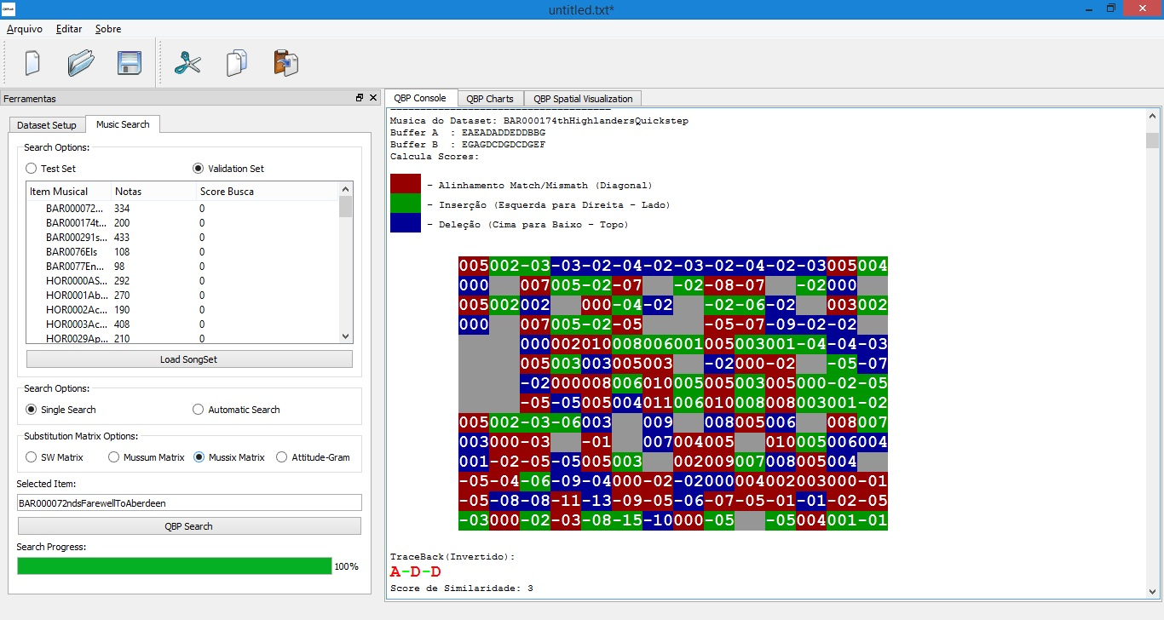
O n-Gram Attitude

Slide 6
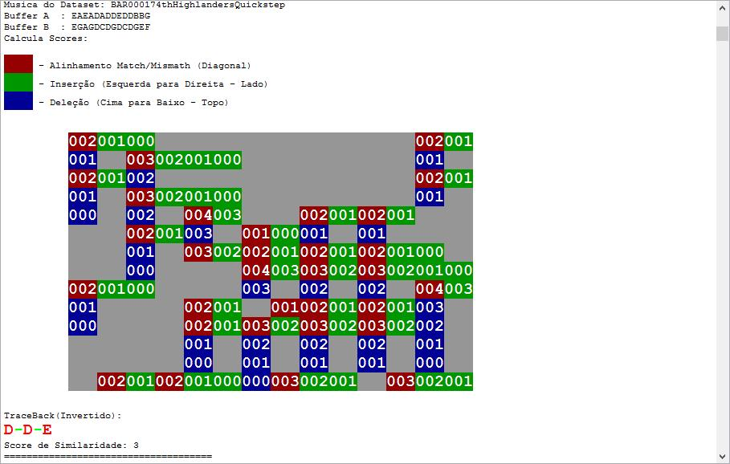
O n-Gram Attitude

Slide 7
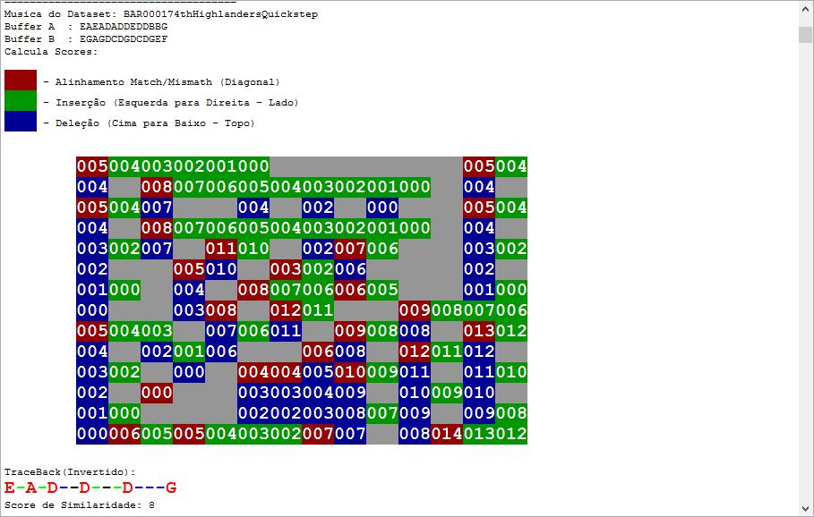
O n-Gram Attitude

Slide 8
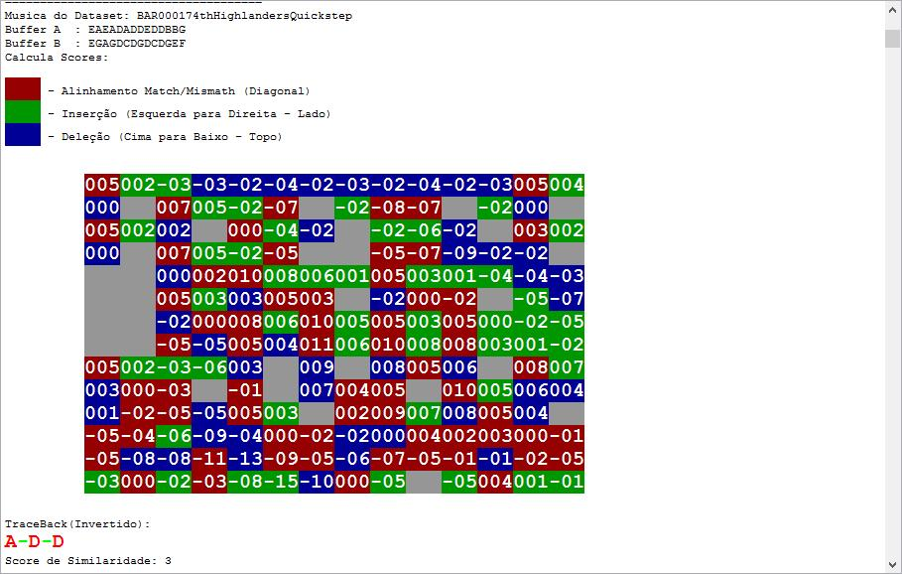
O n-Gram Attitude

